Slide 1
Power and Design for Cluster Random Assignment Experiments
Lecture 3: Extending the Formula
Randall Juras
March 2014

Slide 2
Plan for the Course
Lecture 1: Basic Ideas and Review
Lecture 2: The Cluster Power Formula
Lecture 3: Extending the Formula
Lecture 4: Applications and Other Issues

Slide 3
Plan for Lecture 3
Verify our spreadsheet results using Optimal Design and Power Up
Modify the spreadsheet to account for covariates
Modify the spreadsheet to account for unbalanced designs
What to do with binary outcomes

Slide 4
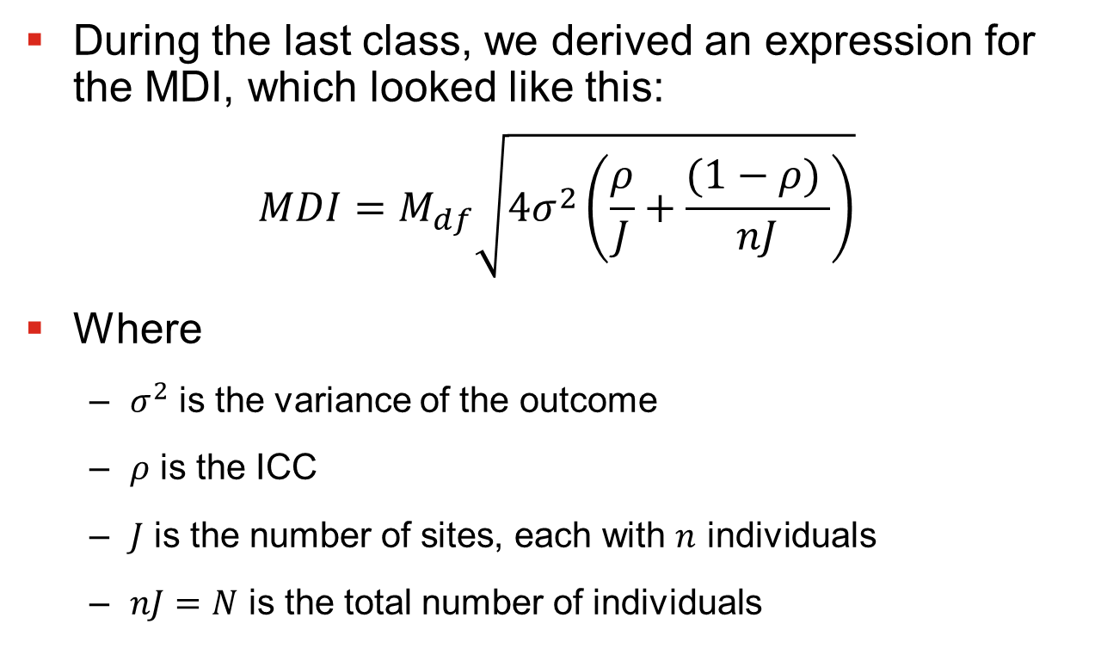
Review: Basic MDI/MDES
During the last class, we derived an expression for the MDI, which looked like this:
$$MDI=M_{df}\sqrt{4σ_{}^{2}\left(\frac{ρ}{J}+\frac{(1−ρ) }{nJ}\right)}$$
Where
$σ_{}^{2}$ is the variance of the outcome
$ρ$ is the ICC
$J$ is the number of sites, each with $n$ individuals
$nJ=N$ is the total number of individuals

Slide 5
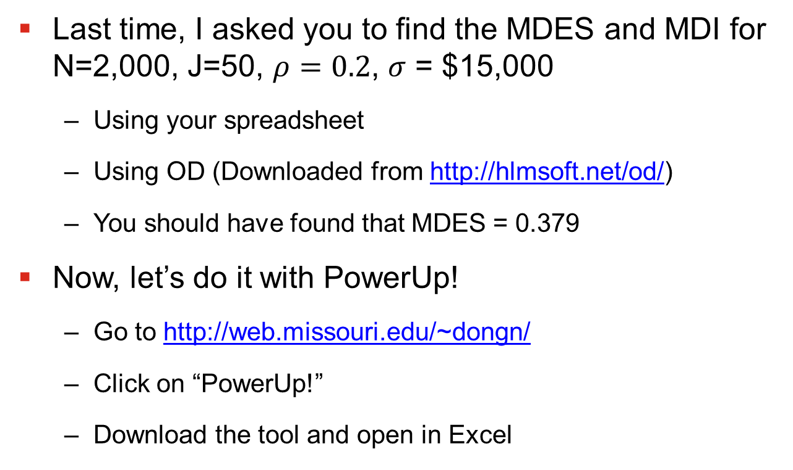
Sample Problem
Last time, I asked you to find the MDES and MDI for N=2,000, J=50, $ρ=0.2$, $σ$ = $15,000
Using your spreadsheet
Using OD (Downloaded from http://hlmsoft.net/od/)
You should have found that MDES = 0.379
Now, let’s do it with PowerUp!
Go to http://web.missouri.edu/~dongn/
Click on “PowerUp!”
Download the tool and open in Excel

Slide 6
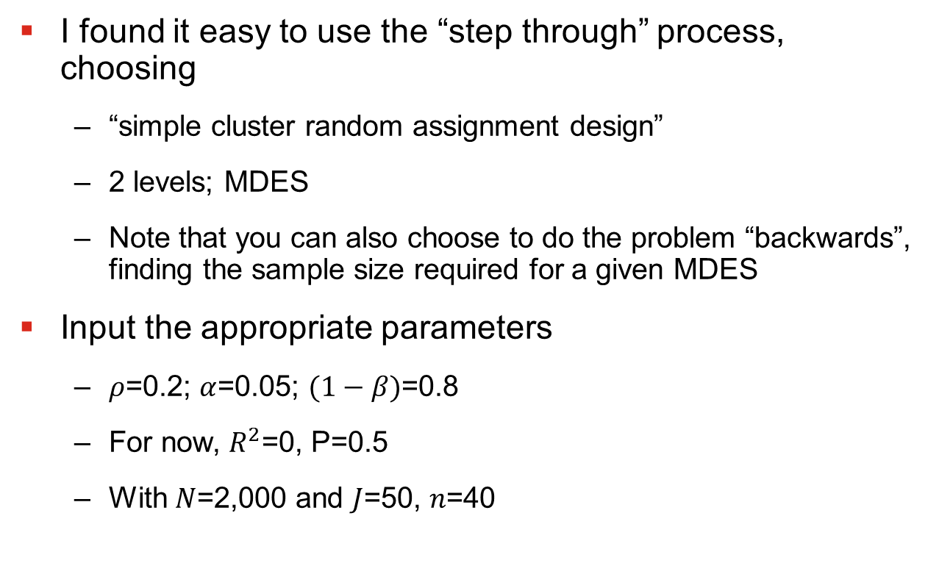
Power Up!
I found it easy to use the “step through” process, choosing
“simple cluster random assignment design”
2 levels; MDES
Note that you can also choose to do the problem “backwards”, finding the sample size required for a given MDES
Input the appropriate parameters
$ρ$=0.2; $α$=0.05; $(1−β)$=0.8
For now, $R^{2}$=0, P=0.5
With $N$=2,000 and $J$=50, $n$=40

Slide 7
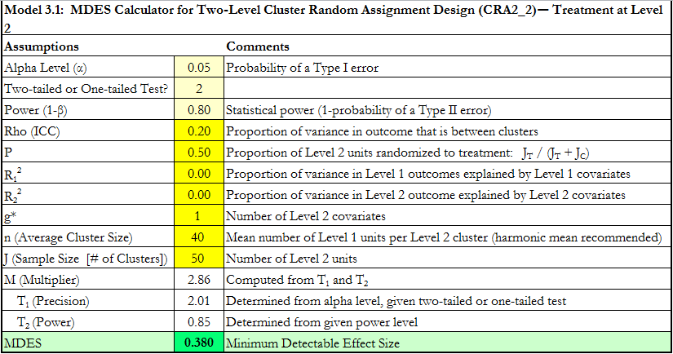
Power Up!

Slide 8
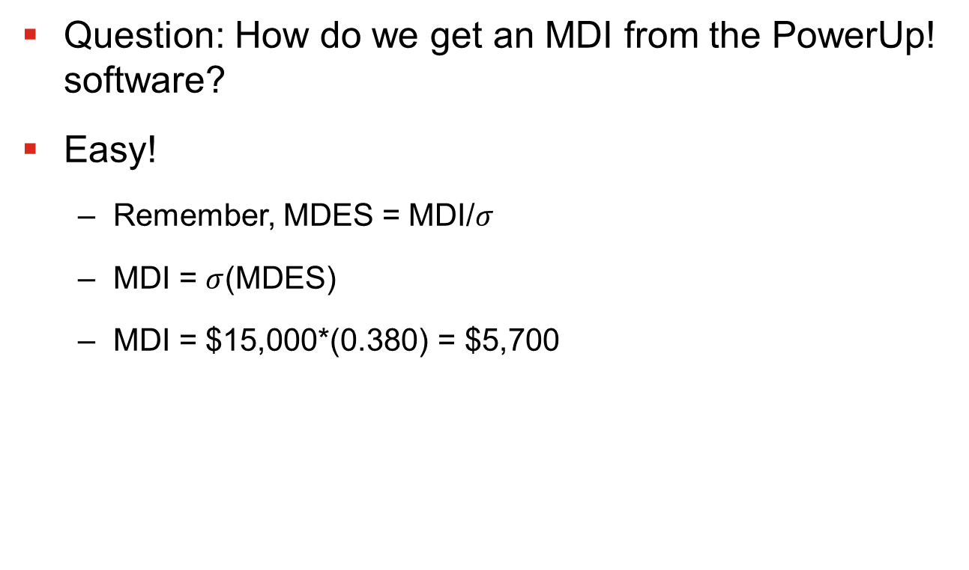
Power Up!
Question: How do we get an MDI from the PowerUp! software?
Easy!
Remember, MDES = MDI/$σ$
MDI = $σ$(MDES)
MDI = $15,000*(0.380) = $5,700

Slide 9
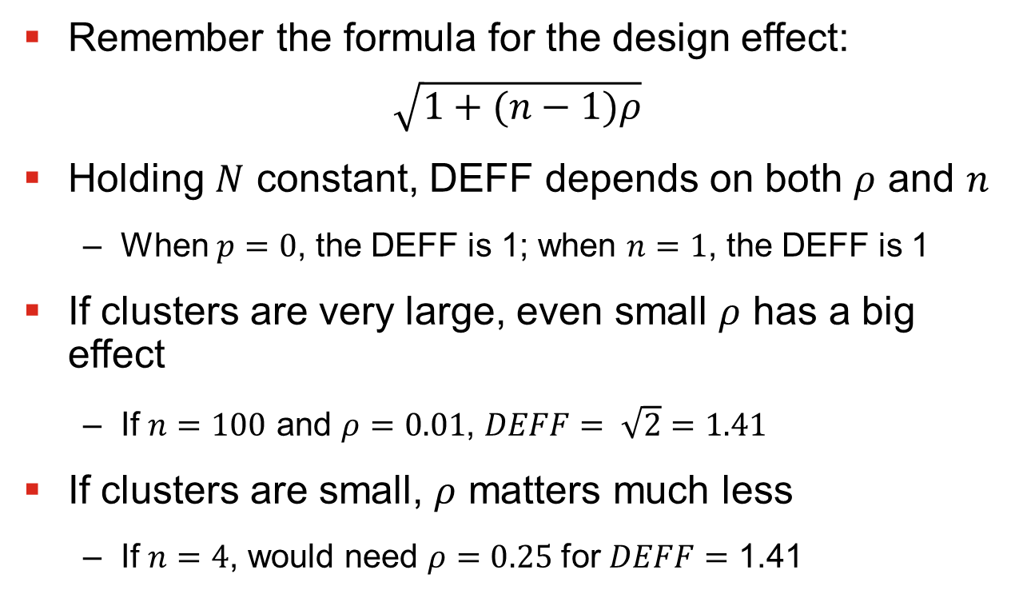
How Much Does Clustering Matter?
Remember the formula for the design effect:
$$\sqrt{1+(n−1)ρ}$$
Holding $N$ constant, DEFF depends on both $ρ$ and $n$
When $p=0$, the DEFF is 1; when $n=1$, the DEFF is 1
If clusters are very large, even small $ρ$ has a big effect
If $n=100$ and $ρ=0.01$, $DEFF= \sqrt{2}=1.41$
If clusters are small, $ρ$ matters much less
If $n=4$, would need $ρ=0.25$ for $DEFF=$ 1.41

Slide 10
Covariates
So far the story is pretty gloomy
Substantial power loss from cluster random assignment
Need big sample sizes to detect reasonable impacts
Just like for individual random assignment, covariates can help
Covariates can explain variation at both Level 1 and Level 2 of the model.
Reducing Level 2 variance can help a lot with power
Important: You don’t even need covariates to be measured at cluster level for this to happen

Slide 11
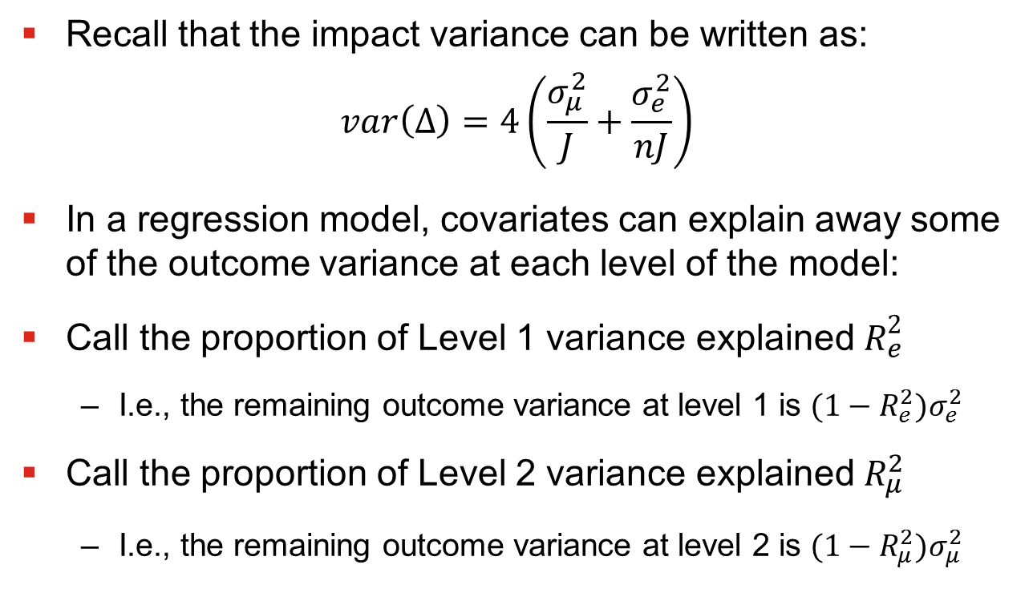
Covariates
Recall that the impact variance can be written as:
$$var\left(∆\right)=4\left(\frac{σ_{μ}^{2}}{J}+\frac{σ_{e}^{2}}{nJ}\right)$$
In a regression model, covariates can explain away some of the outcome variance at each level of the model:
Call the proportion of Level 1 variance explained $R_{e}^{2}$
I.e., the remaining outcome variance at level 1 is ${(1−R_{e}^{2})σ}_{e}^{2}$
Call the proportion of Level 2 variance explained $R_{μ}^{2}$
I.e., the remaining outcome variance at level 2 is ${(1−R_{μ}^{2})σ}_{μ}^{2}$

Slide 12
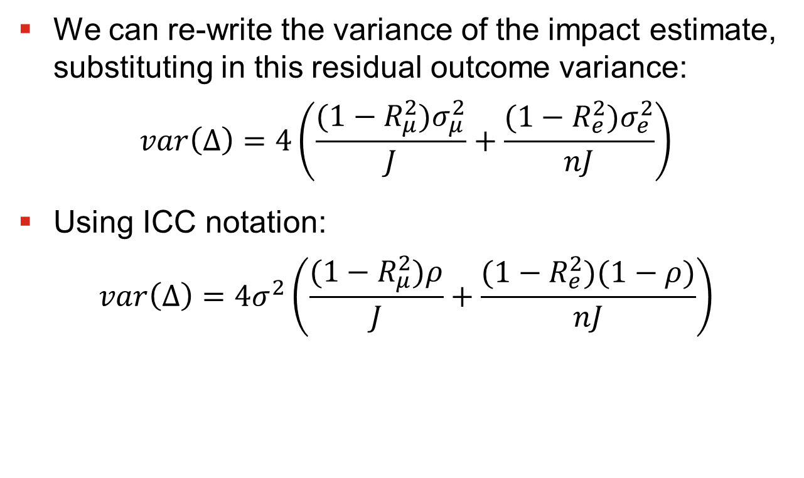
Covariates
We can re-write the variance of the impact estimate, substituting in this residual outcome variance:
$$var\left(∆\right)=4\left(\frac{{(1−R_{μ}^{2})σ}_{μ}^{2}}{J}+\frac{{(1−R_{e}^{2})σ}_{e}^{2}}{nJ}\right)$$
Using ICC notation:
$$var\left(∆\right)=4σ^{2}\left(\frac{(1−R_{μ}^{2})ρ}{J}+\frac{(1−R_{e}^{2})(1−ρ)}{nJ}\right)$$

Slide 13
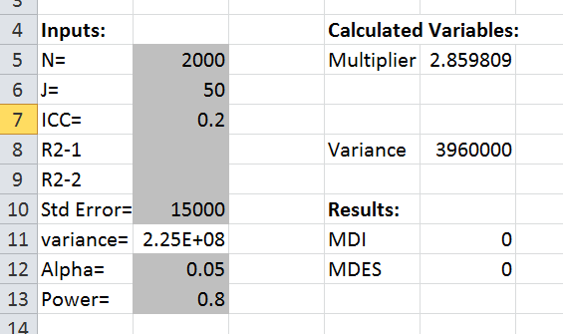
Adding Covariates to Spreadsheet
Adding this functionality to the spreadsheet is easy
First, create fields to input the R-squares
I inserted two new rows to do this

Slide 14
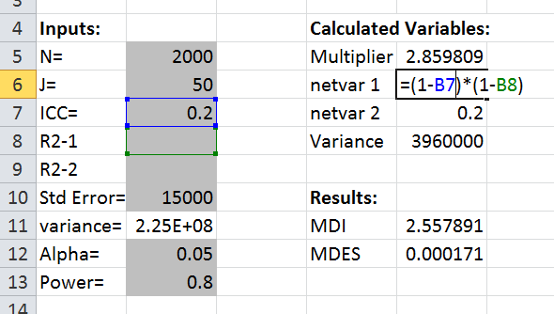

Adding Covariates to Spreadsheet
Now, calculate the residual outcome variance at levels 1 and 2 as $(1−R_{e}^{2})(1−ρ)$ and $(1−R_{μ}^{2})ρ$

Slide 15
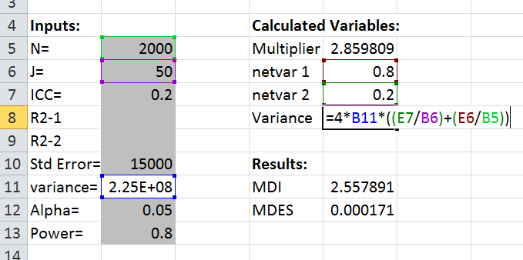
Adding Covariates to Spreadsheet
Finally, substitute these terms for the residual outcome variance into the formula for the variance of the impact estimate:

Slide 16
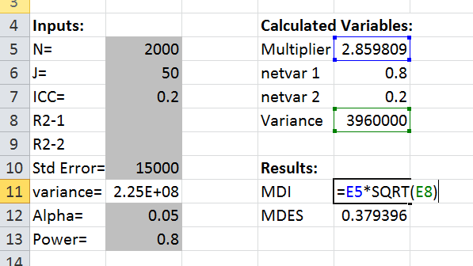
Adding Covariates to Spreadsheet
Finally, make sure to change the cell references in the MDI formula:

Slide 17
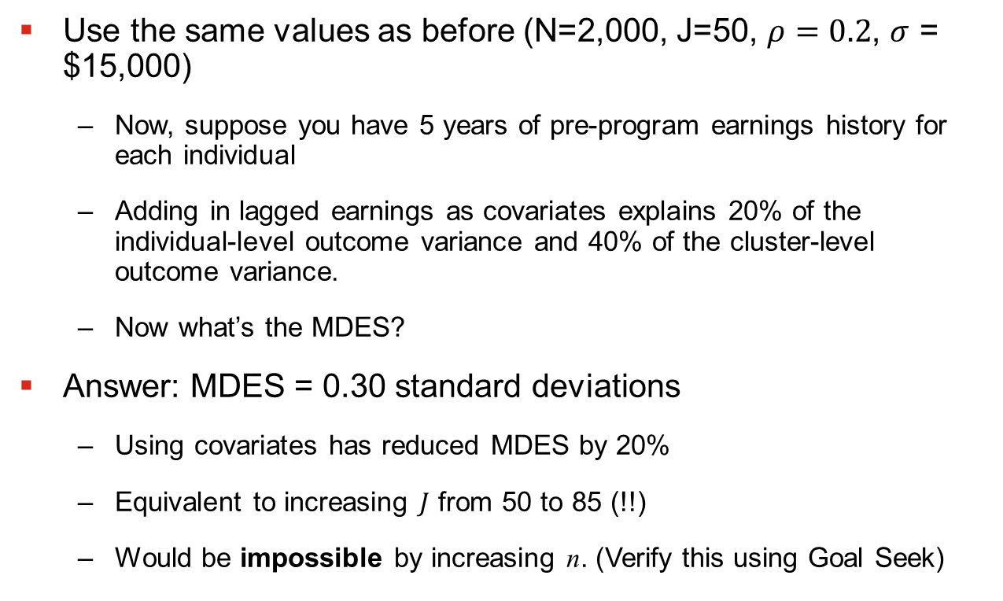
Sample Problem with Covariates
Use the same values as before (N=2,000, J=50, $ρ=0.2$, $σ$ = $15,000)
Now, suppose you have 5 years of pre-program earnings history for each individual
Adding in lagged earnings as covariates explains 20% of the individual-level outcome variance and 40% of the cluster-level outcome variance.
Now what’s the MDES?
Answer: MDES = 0.30 standard deviations
Using covariates has reduced MDES by 20%
Equivalent to increasing $J$ from 50 to 85 (!!)
Would be impossible by increasing n. (Verify this using Goal Seek)

Slide 18
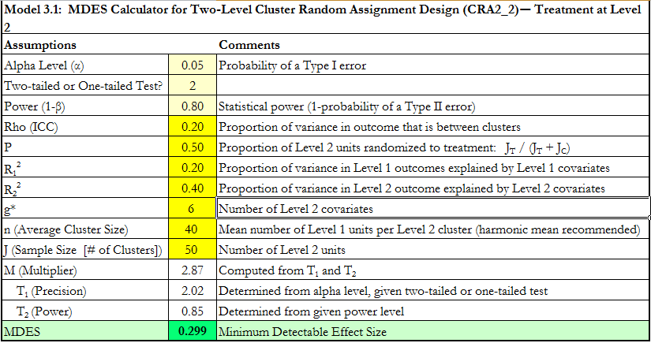

Covariates in Power Up
In PowerUp!, you simply enter the $R_{1}^{2}$ and $R_{2}^{2}$

Slide 19
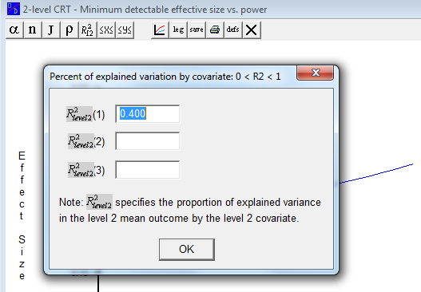

Covariates in Optimal Design
Optimal design does not care about $R_{e}^{2}$. It only wants $R_{μ}^{2}$. (The idea is that $R_{e}^{2}$ is relatively unimportant).

Slide 20
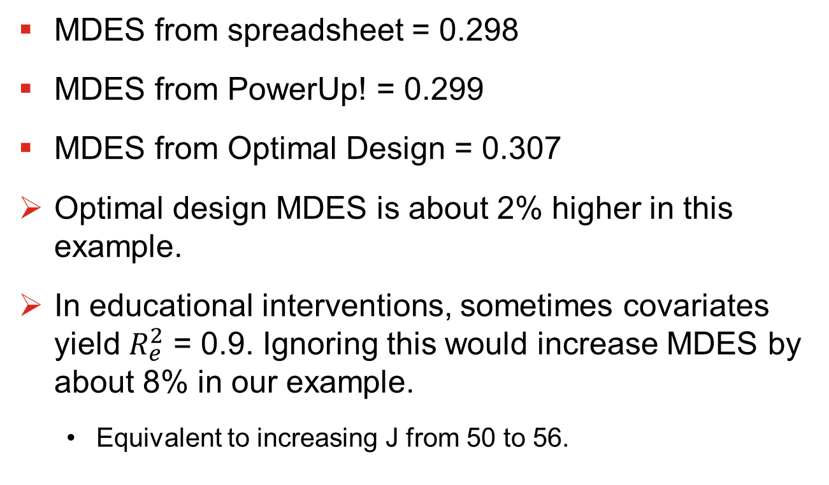

Is the Individual $R^{2}$ Important?
MDES from spreadsheet = 0.298
MDES from PowerUp! = 0.299
MDES from Optimal Design = 0.307
Optimal design MDES is about 2% higher in this example.
In educational interventions, sometimes covariates yield $R_{e}^{2}$ = 0.9. Ignoring this would increase MDES by about 8% in our example.
Equivalent to increasing J from 50 to 56.

Slide 21
Unbalanced Random Assignment
Sometimes you do not want to randomly assign clusters in a 1:1 Treatment-to-Control ratio.
Limited funding for program implementation
Would imply more assigned to control
Desire not to exclude too many from the treatment
Would imply more assigned to treatment
We can modify the formula for MDI/MDES to account for this.
But I am not going to walk through all the derivations; just provide some intuition

Slide 22
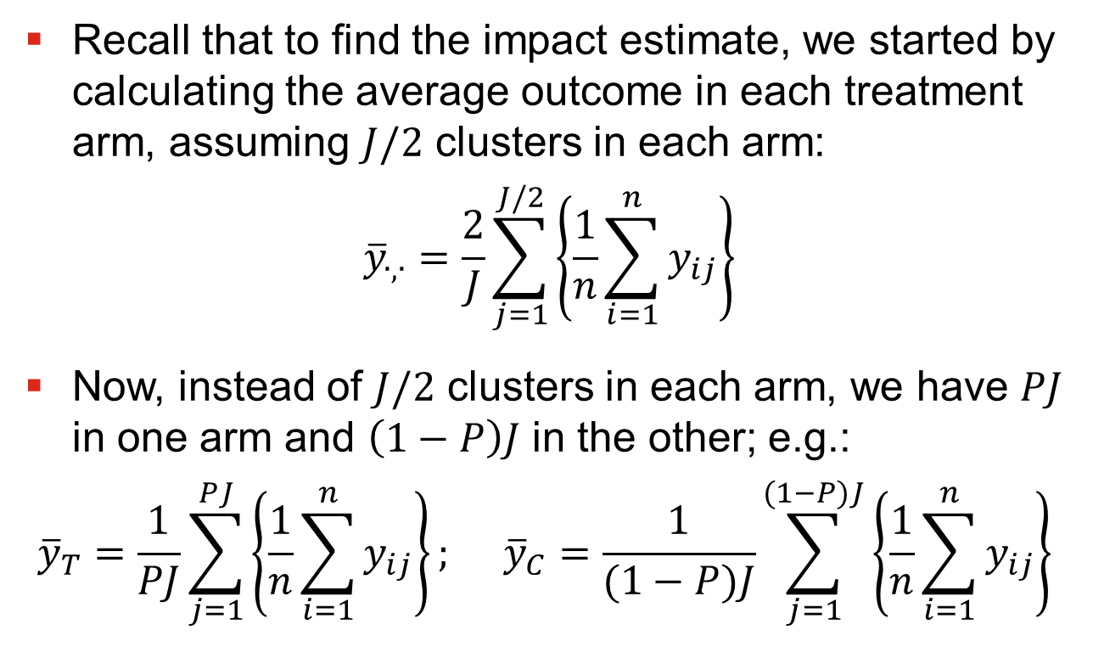
Unbalanced Random Assignment
Recall that to find the impact estimate, we started by calculating the average outcome in each treatment arm, assuming $J/2$ clusters in each arm:
$${\overline{y}}_{∙,∙}=\frac{2}{J}\sum_{j=1}^{J/2}{\left\{\frac{1}{n}\sum_{i=1}^{n}{y_{ij}}\right\}}$$
Now, instead of $J/2$ clusters in each arm, we have $PJ$ in one arm and $\left(1−P\right)J$ in the other; e.g.:
$${\overline{y}}_{T}=\frac{1}{PJ}\sum_{j=1}^{PJ}{\left\{\frac{1}{n}\sum_{i=1}^{n}{y_{ij}}\right\}; }{\overline{y}}_{C}=\frac{1}{(1−P)J}\sum_{j=1}^{(1−P)J}{\left\{\frac{1}{n}\sum_{i=1}^{n}{y_{ij}}\right\}}$$

Slide 23
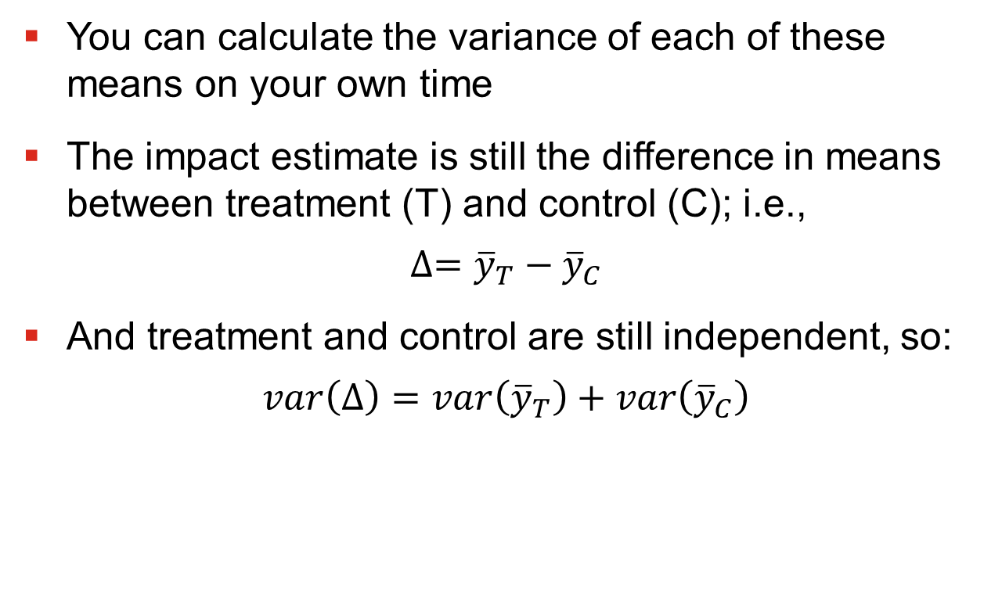
Unbalanced Random Assignment
You can calculate the variance of each of these means on your own time
The impact estimate is still the difference in means between treatment (T) and control (C); i.e.,
$$∆={\overline{y}}_{T}−{\overline{y}}_{C}$$
And treatment and control are still independent, so:
$$var\left(∆\right)=var\left({\overline{y}}_{T}\right)+var\left({\overline{y}}_{C}\right)$$

Slide 24
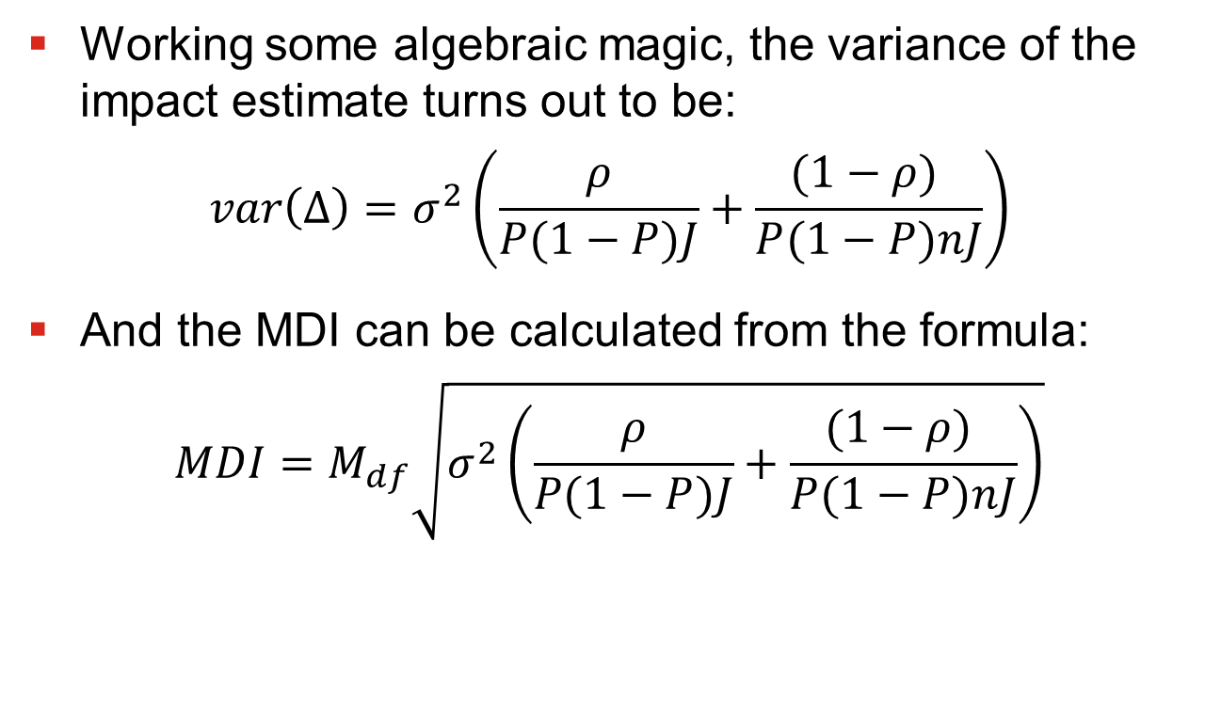
Unbalanced Random Assignment
Working some algebraic magic, the variance of the impact estimate turns out to be:
$$var\left(∆\right)=σ_{}^{2}\left(\frac{ρ}{P(1−P)J}+\frac{(1−ρ) }{P(1−P)nJ}\right)$$
And the MDI can be calculated from the formula:
$$MDI=M_{df}\sqrt{σ_{}^{2}\left(\frac{ρ}{P(1−P)J}+\frac{(1−ρ) }{P(1−P)nJ}\right)}$$

Slide 25
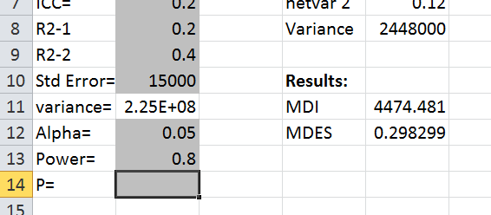

Imbalance in the Spreadsheet
We only need to make a couple changes to incorporate this in the spreadsheet
First, Add a field for entering $P$
It does not matter if $P$ represents the proportion assigned to treatment or the proportion assigned to control

Slide 26
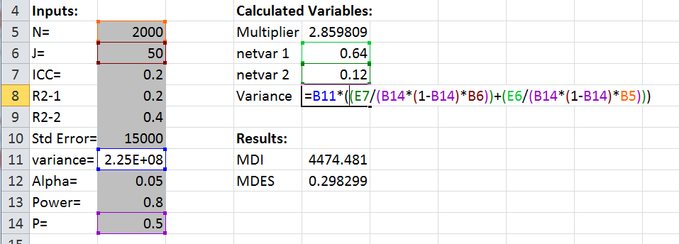

Imbalance in the Spreadsheet
Now, simply need to change the formula for the impact variance to incorporate $P(1−P)$
Remember to take out the “4”, or you are double counting!

Slide 27
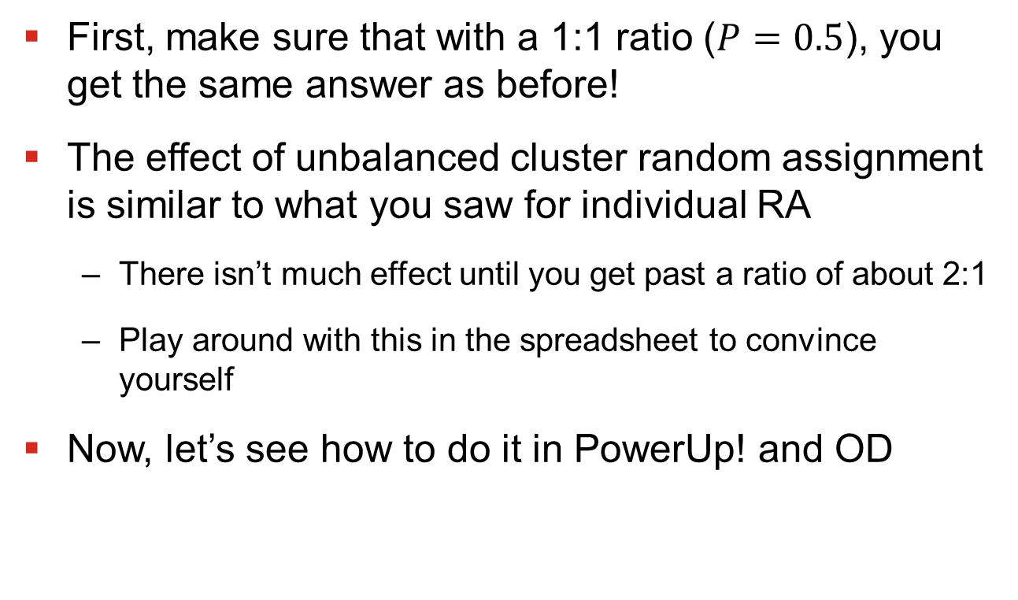
Unbalanced RA in Practice
First, make sure that with a 1:1 ratio ($P=0.5$), you get the same answer as before!
The effect of unbalanced cluster random assignment is similar to what you saw for individual RA
There isn’t much effect until you get past a ratio of about 2:1
Play around with this in the spreadsheet to convince yourself
Now, let’s see how to do it in PowerUp! and OD

Slide 28
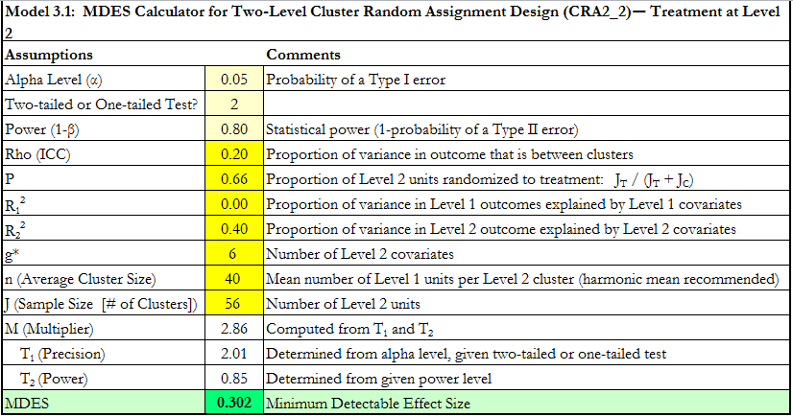

Unbalanced RA in PowerUp
Easy; just change the value for $P$

Slide 29
Unbalanced RA in OD
Surprisingly, Optimal Design does not appear to be capable of accounting for unbalanced designs
As far as I know.
This is probably because it would have to link to other functionality, like cost optimization tool

Slide 30
Binary Variables
Everything we have done so far assumes a continuous outcome, like earnings or test scores
What should we do with a binary outcome (e.g., employment)?
This problem turns out to be quite difficult to solve!
The easiest thing to do is to use a linear probability model; i.e. pretend the outcome is continuous.
This will give you approximately the right answer in most cases

Slide 31
Binary Variables
If you want to learn more, the OD documentation has a good discussion of cluster analysis with binary outcomes
See page 150; Section V: “Optimal Design Plus for cluster randomized trials (binary outcomes)”
OD software also accommodates binary outcomes
Design -> Cluster randomized trials with person level outcomes -> Cluster randomized trials -> Treatment at level 2 -> Power on y-axis (binary outcome)
Must calculate something called a “plausible interval”; not clear exactly what this is
As far as I know, their methodology has not been peer reviewed

Slide 32
An Unanswered Question
Since these things are so easy to do in PowerUp! And Optimal Design, why have we spent all this time making a spreadsheet?
It forces you to think about what’s going on behind the interface
I would use the commercial software for most simple problems – It’s well-established and hard to screw up!
That said, commercial software sometimes won’t do things that you can program yourself (e.g., OD will not account for unbalanced designs)

Slide 33
Next Lecture
Other topics!
How to find the minimum cost evaluation design
How to find ICCs using existing data
What else do you most want to know?

Slide 34
Power and Design for Cluster Random Assignment Experiments
Lecture 4: Other Issues
Randall Juras
March 2014

Slide 35
Plan for the Course
Lecture 1: Basic Ideas and Review
Lecture 2: The Cluster Power Formula
Lecture 3: Extending the Formula
Lecture 4: Other Issues

Slide 36
Plan for Lecture 4
Subgroups
Actual MDI and MDES
Evaluation Cost: Optimal mix of n and J for a given budget
Brief Treatment of Other Issues:
Multi-Arm Experiments
Three-level models
Clusters of different sizes
Repeated Observations

Slide 37
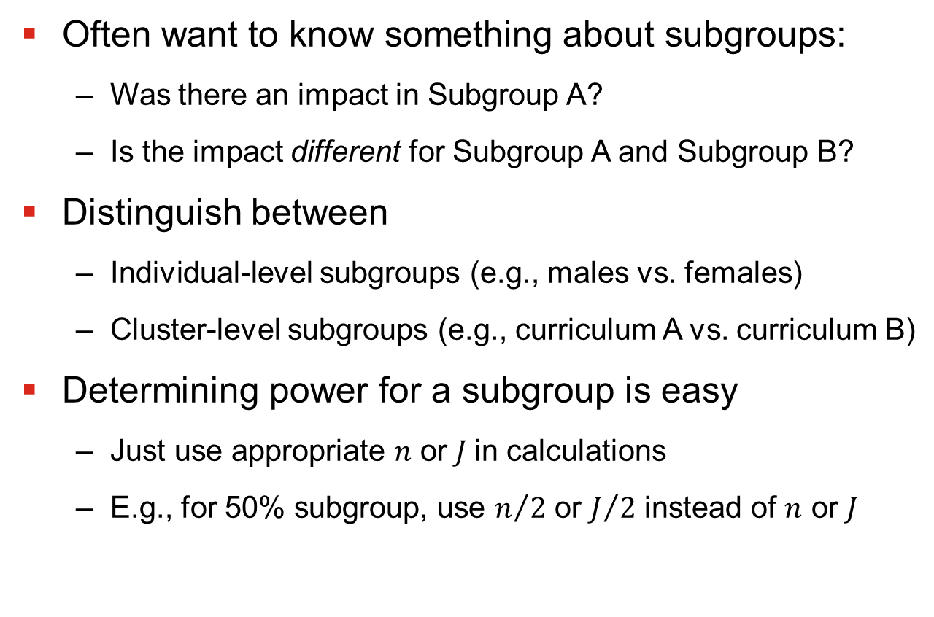
Subgroups
Often want to know something about subgroups:
Was there an impact in Subgroup A?
Is the impact different for Subgroup A and Subgroup B?
Distinguish between
Individual-level subgroups (e.g., males vs. females)
Cluster-level subgroups (e.g., curriculum A vs. curriculum B)
Determining power for a subgroup is easy
Just use appropriate $n$ or $J$in calculations
E.g., for 50% subgroup, use $n/2$ or $J/2$ instead of $n$ or $J$

Slide 38

Differences Between Subgroups
To calculate MDI for a difference between two independent subgroups, use our handy rule
The variance of a difference is the sum of variances
$$var\left(∆_{A}−∆_{B}\right)=var\left(∆_{A}\right)+var(∆_{B})$$
For 50% subgroups:
$$var\left(∆_{A}−∆_{B}\right)=2var\left(∆_{A}\right)$$
Where $var\left(∆_{A}\right)$ is calculated using $n/2$ or $J/2$ instead of $n$ or $J$

Slide 39
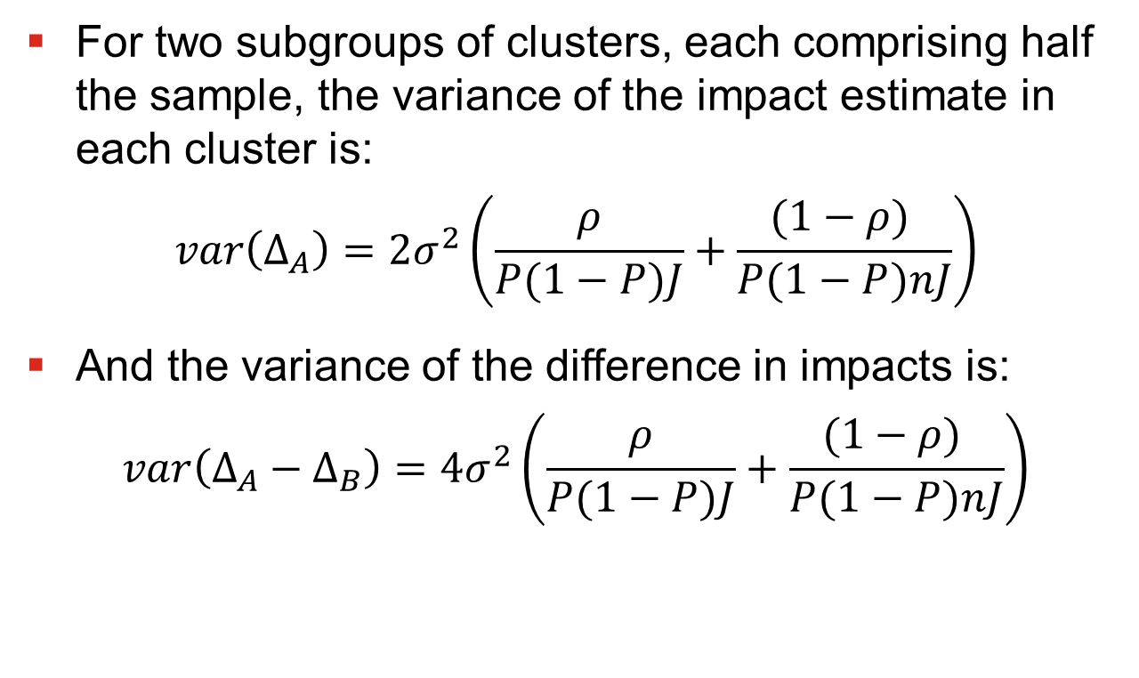
Differences Between Subgroups
For two subgroups of clusters, each comprising half the sample, the variance of the impact estimate in each cluster is:
$$var\left(∆_{A}\right)={2σ}_{}^{2}\left(\frac{ρ}{P(1−P)J}+\frac{(1−ρ) }{P(1−P)nJ}\right)$$
And the variance of the difference in impacts is:
$$var\left(∆_{A}−∆_{B}\right)={4σ}_{}^{2}\left(\frac{ρ}{P(1−P)J}+\frac{(1−ρ) }{P(1−P)nJ}\right)$$

Slide 40
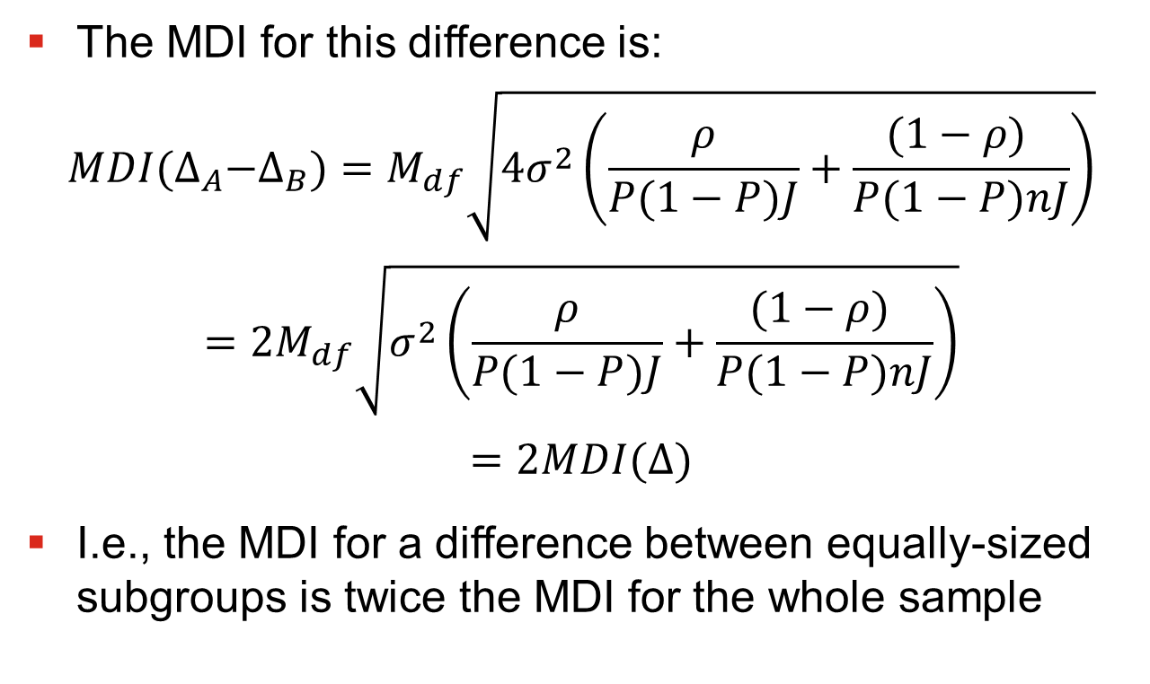
Differences Between Subgroups
The MDI for this difference is:
$$MDI{(∆}_{A}−∆_{B})=M_{df}\sqrt{{4σ}_{}^{2}\left(\frac{ρ}{P(1−P)J}+\frac{(1−ρ) }{P(1−P)nJ}\right)}$$
$$=2M_{df}\sqrt{σ_{}^{2}\left(\frac{ρ}{P(1−P)J}+\frac{(1−ρ) }{P(1−P)nJ}\right)}$$
$$=2MDI(∆)$$
I.e., the MDI for a difference between equally-sized subgroups is twice the MDI for the whole sample

Slide 41
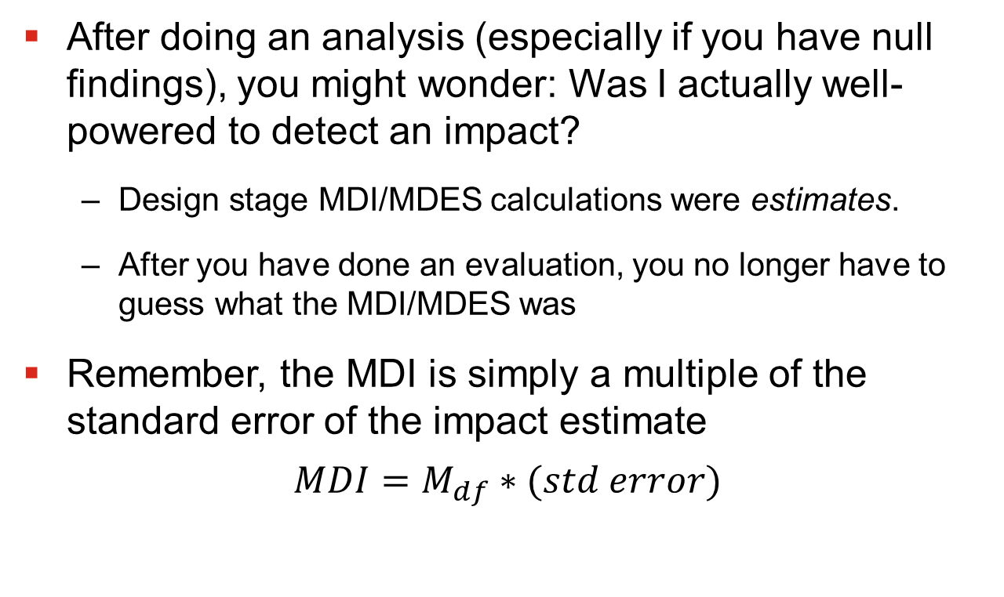
Actual (Ex-post) MDI/MDES
After doing an analysis (especially if you have null findings), you might wonder: Was I actually well-powered to detect an impact?
Design stage MDI/MDES calculations were estimates.
After you have done an evaluation, you no longer have to guess what the MDI/MDES was
Remember, the MDI is simply a multiple of the standard error of the impact estimate
$$MDI=M_{df}∗(std error)$$

Slide 42
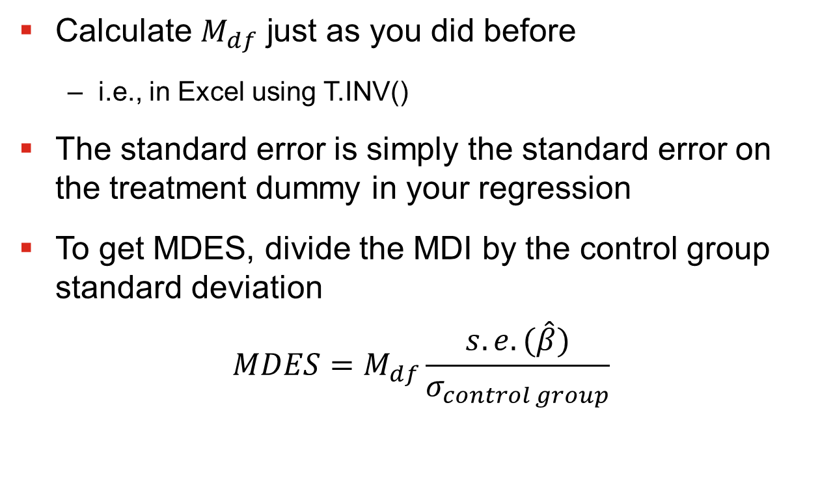
Actual (Ex-post) MDI/MDES
Calculate $M_{df}$ just as you did before
i.e., in Excel using T.INV()
The standard error is simply the standard error on the treatment dummy in your regression
To get MDES, divide the MDI by the control group standard deviation
$$MDES=M_{df}\frac{s.e.(\hat{β})}{σ_{control group}}$$

Slide 43
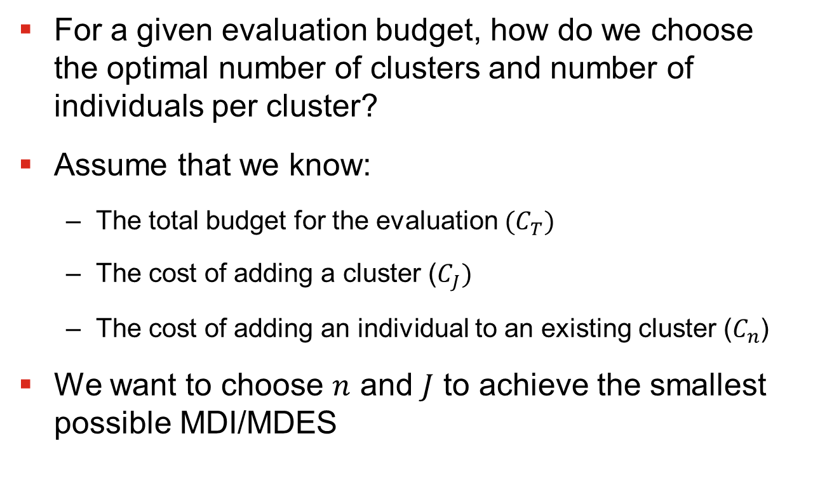
Optimal Mix of n and J
For a given evaluation budget, how do we choose the optimal number of clusters and number of individuals per cluster?
Assume that we know:
The total budget for the evaluation $(C_{T})$
The cost of adding a cluster ($C_{J})$
The cost of adding an individual to an existing cluster ($C_{n}$)
We want to choose $n$ and $J$ to achieve the smallest possible MDI/MDES

Slide 44
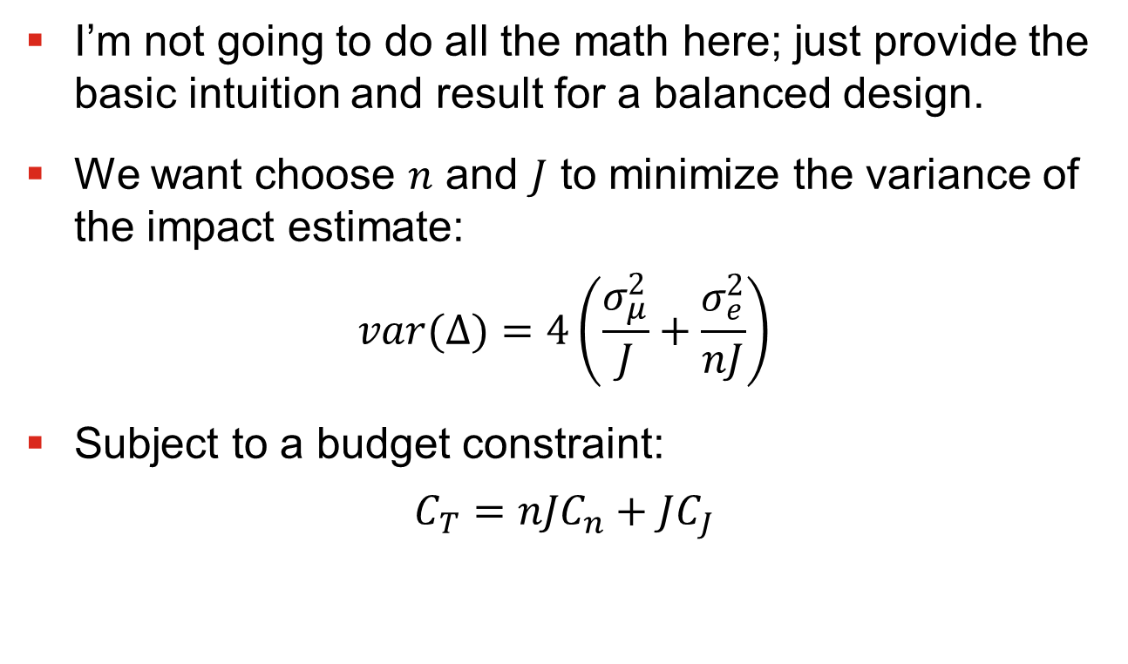
Optimal Mix of n and J
I’m not going to do all the math here; just provide the basic intuition and result for a balanced design.
We want choose $n$ and $J$ to minimize the variance of the impact estimate:
$$var(∆)=4\left(\frac{σ_{μ}^{2}}{J}+\frac{σ_{e}^{2}}{nJ}\right)$$
Subject to a budget constraint:
$$C_{T}={nJC}_{n}+JC_{J}$$

Slide 45
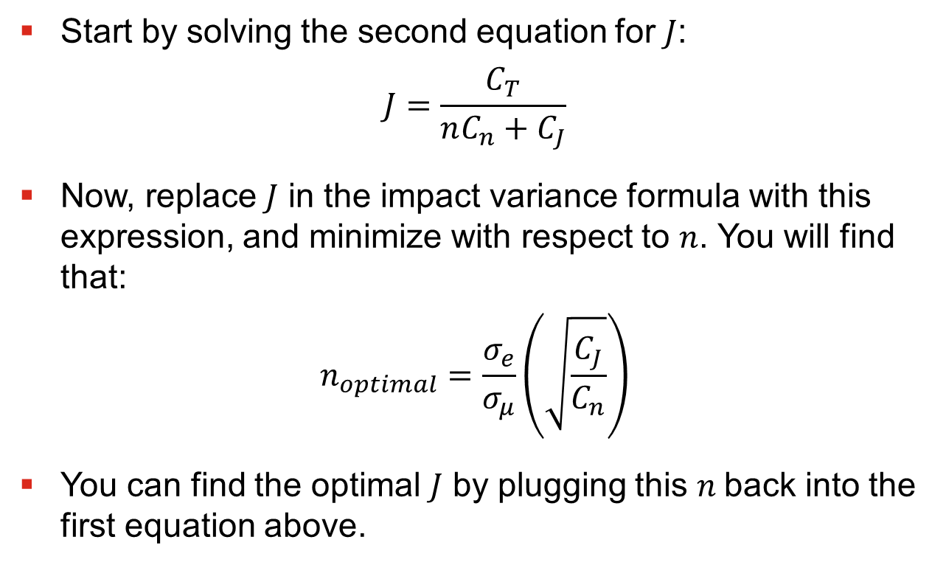
Optimal Mix of n and J
Start by solving the second equation for $J$:
$$J=\frac{C_{T}}{nC_{n}+C_{J}}$$
Now, replace $J$ in the impact variance formula with this expression, and minimize with respect to $n$. You will find that:
$$n_{optimal}=\frac{σ_{e}}{σ_{μ}}\left(\sqrt{\frac{C_{J}}{C_{n}}}\right)$$
You can find the optimal $J$ by plugging this $n$back into the first equation above.

Slide 46
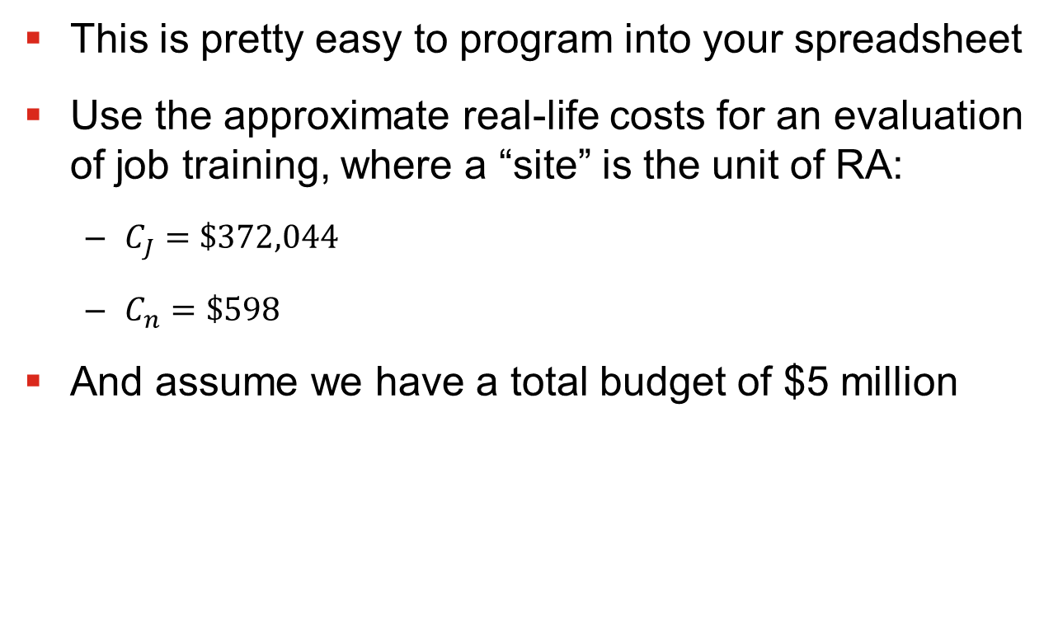
Optimal Mix of n and J
This is pretty easy to program into your spreadsheet
Use the approximate real-life costs for an evaluation of job training, where a “site” is the unit of RA:
$C_{J}=\$372,044$
$C_{n}=\$598$
And assume we have a total budget of $5 million

Slide 47
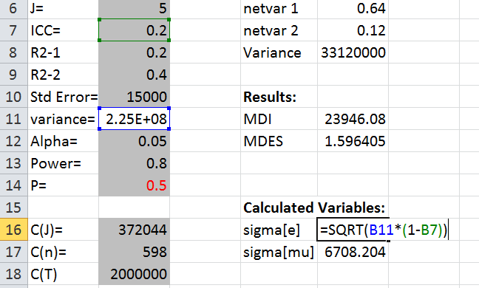

Optimal Mix of n and J
Start by entering the three costs, and calculate $σ_{e}$ and $σ_{μ}$

Slide 48
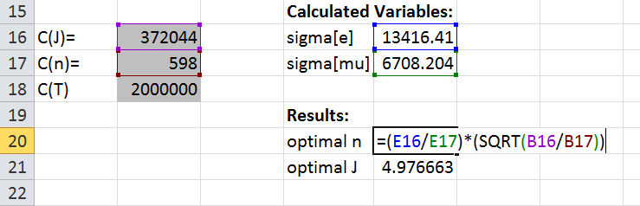
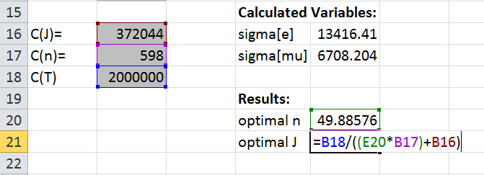

Optimal Mix of n and J
Now, enter formulas for the optimal $n$ and $J$
Result: Need 5 sites and 49 individuals per site

Slide 49
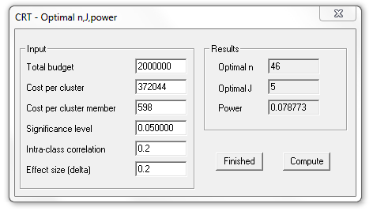
Optimal Mix of n and J
Optimal Design has a tool to do this too
Click through to “optimal sample allocation under budgetary constraints” -> “equal costs” -> maximizing power
OD shows that we need 5 sites and 46 individuals per site

Slide 50
Multi-Arm Experiments
Q: How do you calculate MDI/MDES for a multi-arm experiment?
E.g., with two treatment arms and a control arm
A: You can use the formulas already presented for each pairwise comparison
Using the appropriate sample sizes and T/C ratio
With three or more arms: this is pretty tedious to program!
I have an example spreadsheet I can give you if you ask
Or, you can just do each comparison separately
OD and PowerUp! do not have this functionality built in

Slide 51
Three-Level Models
Some designs have more than one level of clustering
E.g. students nested within classes nested within schools
Where schools are the unit of random assignment
If you think there are substantial differences between classrooms, you may want to explicitly account for this variability in your model
A paper by Zhu, Jacob, Bloom, and Xu (2011) shows that ignoring clustering at the middle level of a 3-level model does not alter the results
Title: “Designing and Analyzing Studies That Randomize Schools to Estimate Intervention Effects on Student Academic Outcomes Without Classroom-Level Information”

Slide 52
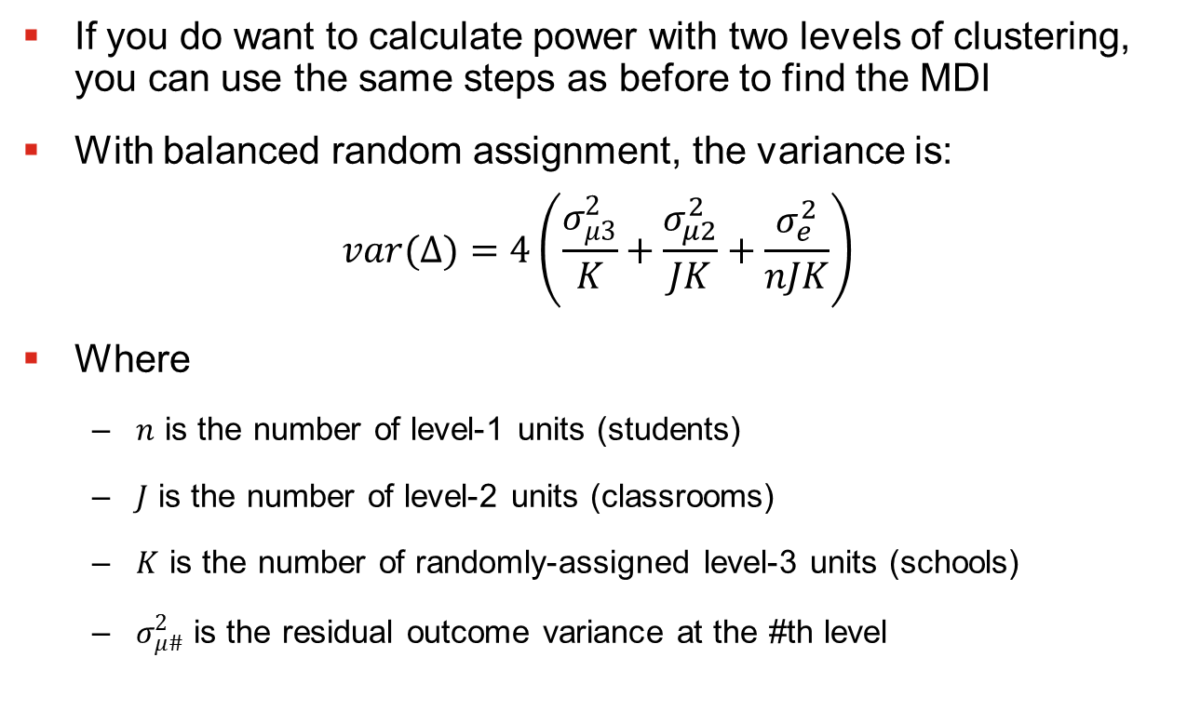
Three-Level Models
If you do want to calculate power with two levels of clustering, you can use the same steps as before to find the MDI
With balanced random assignment, the variance is:
$$var(∆)=4\left(\frac{σ_{μ3}^{2}}{K}+\frac{σ_{μ2}^{2}}{JK}+\frac{σ_{e}^{2}}{nJK}\right)$$
Where
$n$ is the number of level-1 units (students)
$J$ is the number of level-2 units (classrooms)
$K$ is the number of randomly-assigned level-3 units (schools)
$σ_{μ\#}^{2}$ is the residual outcome variance at the #th level

Slide 53
Finding ICC Using Data
You can find the ICC for a given outcome and level of clustering using HLM software, e.g., Stata’s <xtmixed> command
In general, the Stata syntax is
xtmixed y || clusterid:
Where
xtmixed is the command
y is the outcome of interest
clusterid identifies the clusters
If the data are pooled across T and C, you would also need a treatment dummy

Slide 54
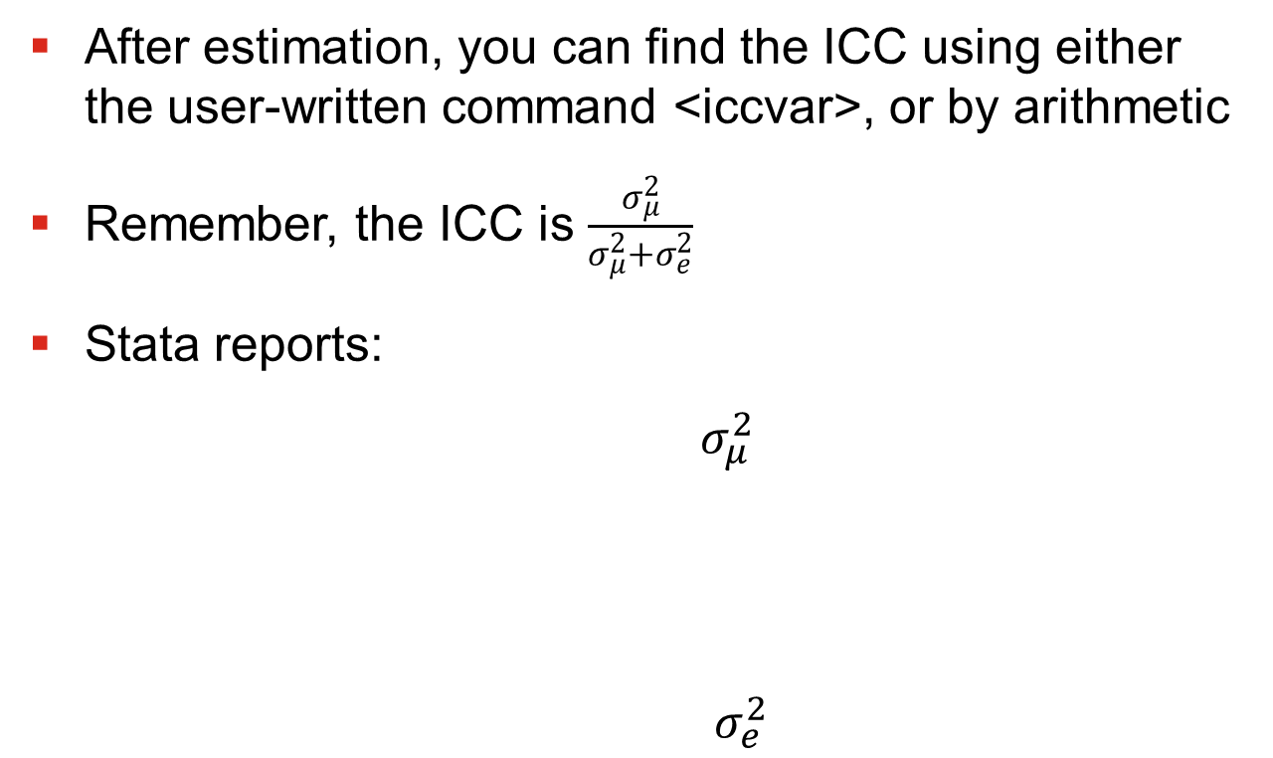
Finding ICC Using Data
After estimation, you can find the ICC using either the user-written command <iccvar>, or by arithmetic
Remember, the ICC is $\frac{σ_{μ}^{2}}{σ_{μ}^{2}+σ_{e}^{2}}$
Stata reports:
$σ_{μ}^{2}$
$σ_{e}^{2}$

Slide 55
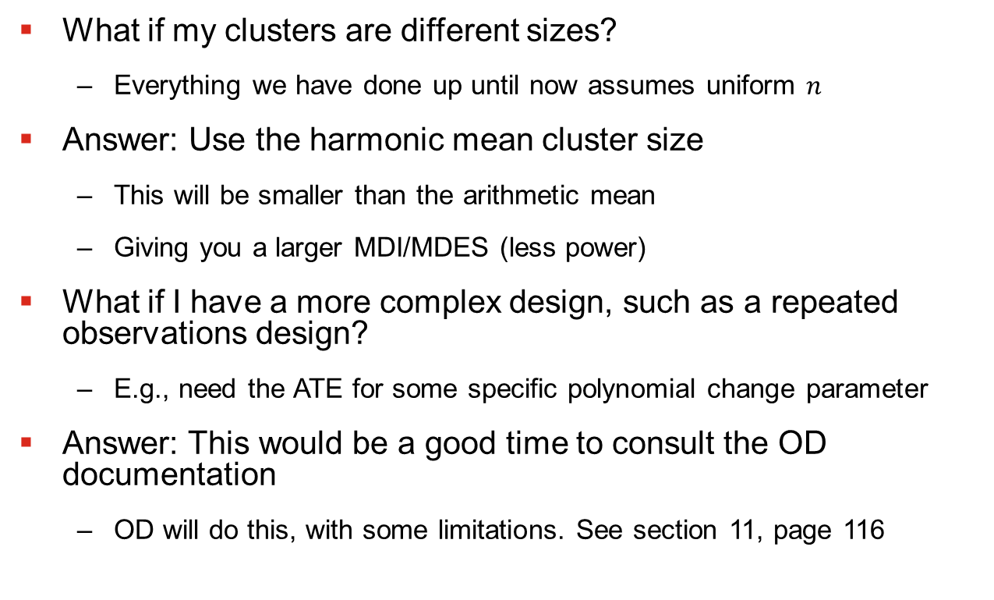
Some Other Odds & Ends
What if my clusters are different sizes?
Everything we have done up until now assumes uniform $n$
Answer: Use the harmonic mean cluster size
This will be smaller than the arithmetic mean
Giving you a larger MDI/MDES (less power)
What if I have a more complex design, such as a repeated observations design?
E.g., need the ATE for some specific polynomial change parameter
Answer: This would be a good time to consult the OD documentation
OD will do this, with some limitations. See section 11, page 116

Slide 56
That’s all for now!!

